Slide 1
Basic Syntax/Programs
Md. Alamgir Hossain
Senior Lecturer,
Dept. of CSE, Prime University
Mail: alamgir.cse14.just@gmail.com

Slide 2


User Input-scanf() function
The scanf() function is used for input. It reads the input data from the console.
scanf(“format string”, argument_list);
Example:
1. scanf(“%d”, &n); If int n;
2. scanf(“%f”, &x); If float x;

Slide 3

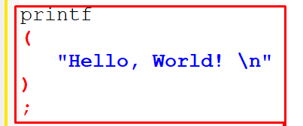
Tokens
A C program consists of various tokens and a token is either a keyword, an identifier, a constant, a string literal, or a symbol. For example, the following C statement consists of five tokens:
The individual tokens are −

Slide 4
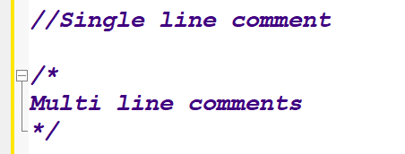
Comments & Identifiers
Comments are like helping text in your C program and they are ignored by the compiler. They start with /* and terminate with the characters */ as shown below −

Slide 5

Identifiers
A C identifier is a name used to identify a variable, function, or any other user-defined item. An identifier starts with a letter A to Z, a to z, or an underscore '_' followed by zero or more letters, underscores, and digits (0 to 9).
C does not allow punctuation characters such as @, $, and % within identifiers. C is a case-sensitive programming language. Thus, Manpower and manpower are two different identifiers in C. Here are some examples of acceptable identifiers −

Slide 6
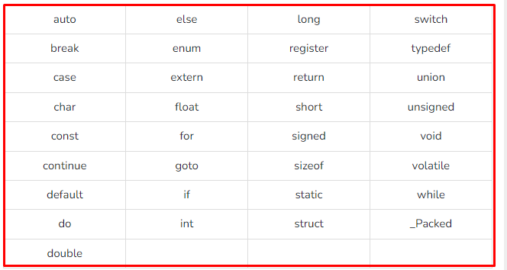
Keywords
The following list shows the reserved words in C. These reserved words may not be used as constants or variables or any other identifier names.

Slide 7
Data Types
Data types in c refer to an extensive system used for declaring variables or functions of different types.
The type of a variable determines how much space it occupies in storage and how the bit pattern stored is interpreted.
Types | Description
Basic Types | They are arithmetic types and are further classified into: (a) integer types and (b) floating-point types.
Enumerated types | They are again arithmetic types and they are used to define variables that can only assign certain discrete integer values throughout the program.
The type void | The type specifier void indicates that no value is available.
Derived types | They include (a) Pointer types, (b) Array types, (c) Structure types, (d) Union types and (e) Function types.

Slide 8
Integer Types
Type | Storage size | Value range
char | 1 byte | -128 to 127 or 0 to 255
unsigned char | 1 byte | 0 to 255
signed char | 1 byte | -128 to 127
int | 2 or 4 bytes | -32,768 to 32,767 or -2,147,483,648 to 2,147,483,647
unsigned int | 2 or 4 bytes | 0 to 65,535 or 0 to 4,294,967,295
short | 2 bytes | -32,768 to 32,767
unsigned short | 2 bytes | 0 to 65,535
long | 8 bytes or (4bytes for 32 bit OS) | -9223372036854775808 to 9223372036854775807
unsigned long | 8 bytes | 0 to 18446744073709551615

Slide 9
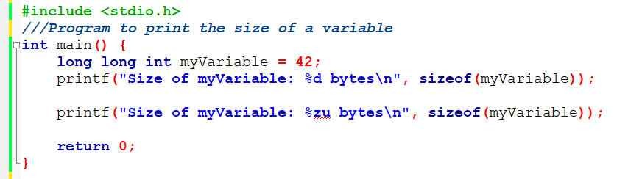
Printing the Size of a Variable

Slide 10
Floating-Point Types
Type | Storage size | Value range | Precision
float | 4 byte | 1.2E-38 to 3.4E+38 | 6 decimal places
double | 8 byte | 2.3E-308 to 1.7E+308 | 15 decimal places
long double | 10 byte | 3.4E-4932 to 1.1E+4932 | 19 decimal places

Slide 11
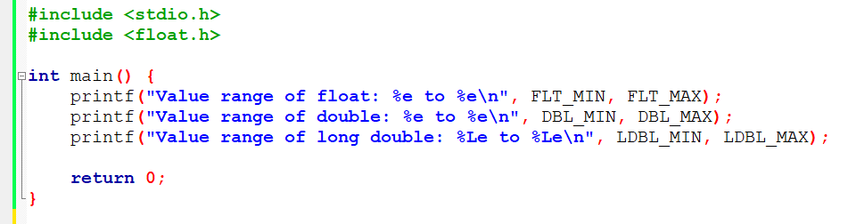
Value Range of Floating-Point Types

Slide 12
void Type
The void type specifies that no value is available. It is used in three kinds of situations −
Types | Description
Function returns as void | There are various functions in C which do not return any value or you can say they return void. A function with no return value has the return type as void. For example, void exit (int status);
Function arguments as void | There are various functions in C which do not accept any parameter. A function with no parameter can accept a void. For example, int rand(void);
Pointers to void | A pointer of type void * represents the address of an object, but not its type. For example, a memory allocation function void *malloc( size_t size ); returns a pointer to void which can be casted to any data type.

Slide 13
Variables
A variable is nothing but a name given to a storage area that our programs can manipulate.
Basic variable types −
Types | Description
char | Typically a single octet(one byte). It is an integer type.
int | The most natural size of integer for the machine.
float | A single-precision floating point value.
double | A double-precision floating point value.
void | Represents the absence of type.

Slide 14
Format Specifiers
Integer Format Specifiers:
%d or %i: Signed integer.
%u: Unsigned integer.
%o: Octal (unsigned integer in octal representation).
%x or %X: Hexadecimal (unsigned integer in hexadecimal representation).
Floating-Point Format Specifiers:
%f: Floating-point number (decimal notation).
%e or %E: Floating-point number (scientific/exponential notation).
%
g or %G: Floating-point number (shortest representation of %f or %e).

Slide 15
Format Specifiers
Character Format Specifiers:
%c: Character.
%s: String (character array).
Pointer Format Specifier:
%p: Pointer address.
Long Integer Format Specifiers:
%ld or %li: Signed long integer.
%lu: Unsigned long integer.
%lo: Unsigned long integer in octal representation.
%lx or %lX: Unsigned long integer in hexadecimal representation.
Long Long Integer Format Specifiers:
%lld or %lli: Signed long long integer.
%llu: Unsigned long long integer.
%llo: Unsigned long long integer in octal representation.
%llx or %llX: Unsigned long long integer in hexadecimal representation.

Slide 16
Format Specifiers
Short Integer Format Specifiers:
%hd or %hi: Signed short integer.
%hu: Unsigned short integer.
%ho: Unsigned short integer in octal representation.
%hx or %hX: Unsigned short integer in hexadecimal representation.
Character Width and Precision:
%Ns: String with a maximum of N characters (e.g., %10s).
%.Nf: Floating-point number with N decimal places (e.g., %.2f).

Slide 17
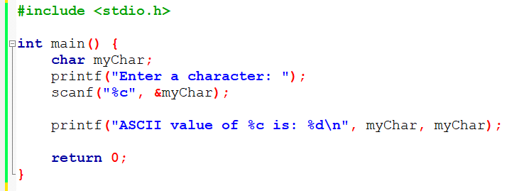
C Program to Print the ASCII Value of a Character

Slide 18
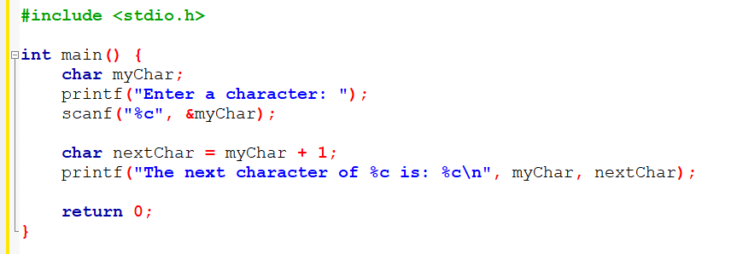
C Program to Prints Next Character in the ASCII Sequence.

Slide 19
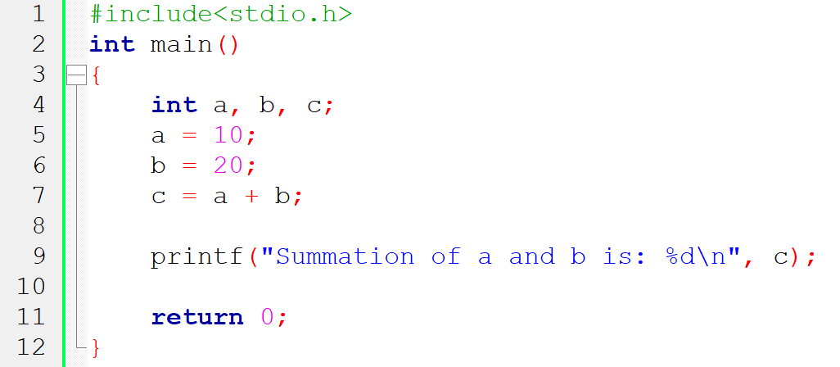
Program for Addition of Two numbers

Slide 20
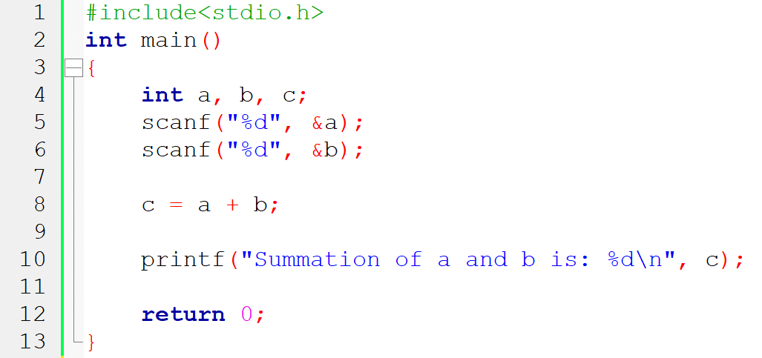
Program for Addition of Two numbers

Slide 21
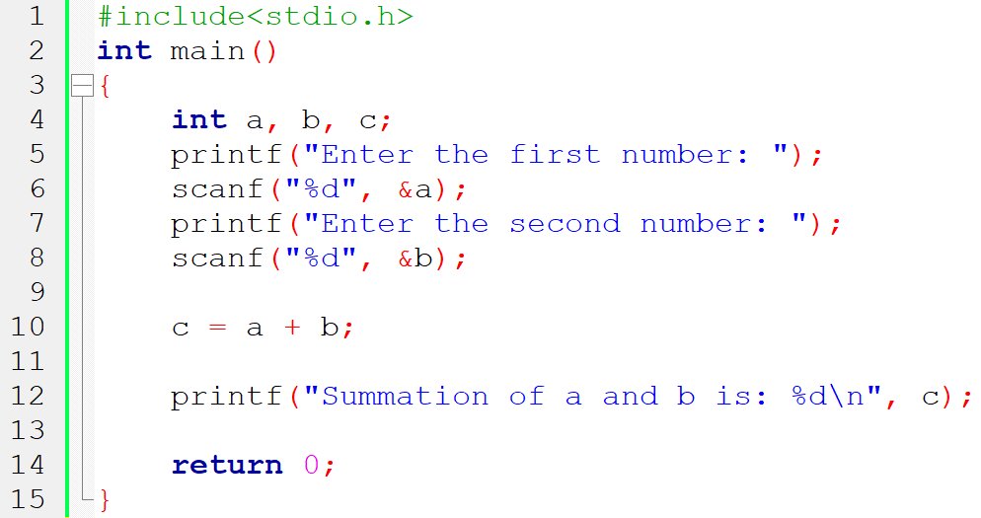
Program for Addition of Two numbers

Slide 22
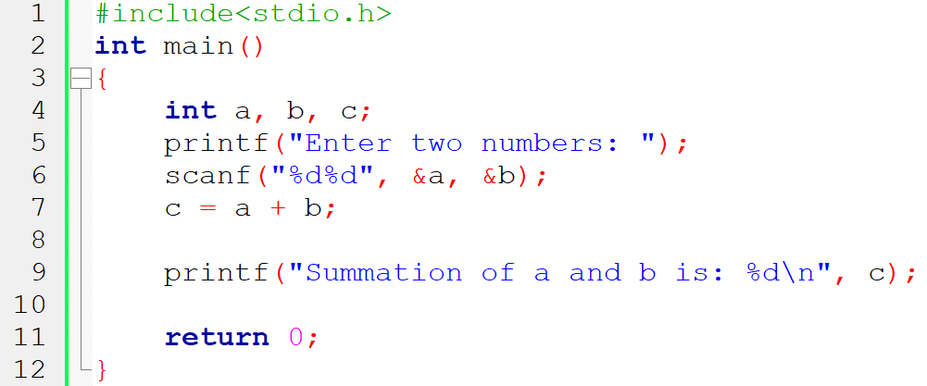
Program for Addition of Two numbers

Slide 23
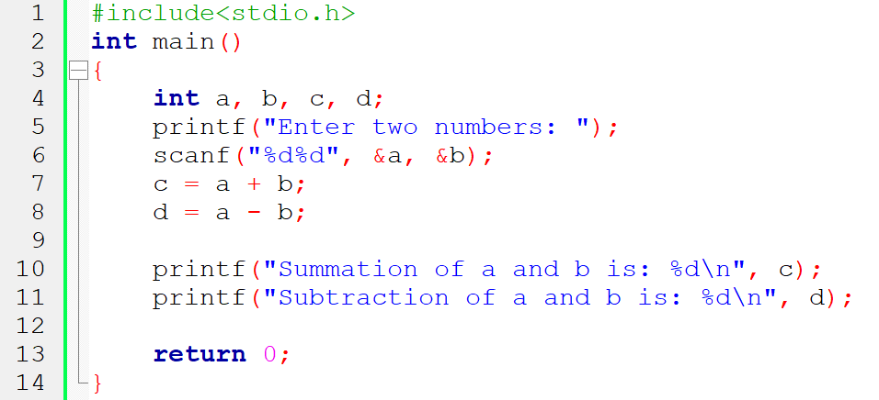
Addition & Subtraction of Two numbers

Slide 24
Addition & Subtraction of Two numbers

Slide 25
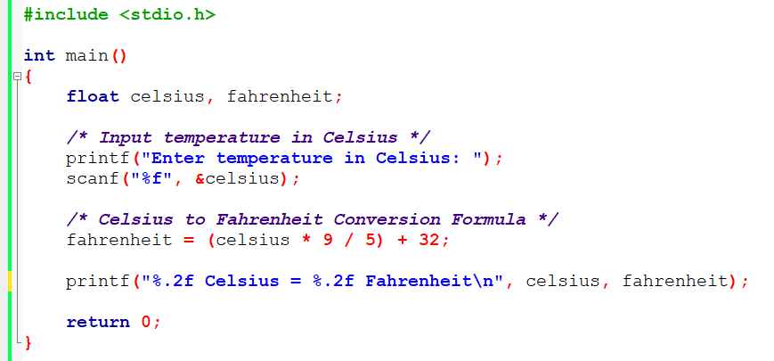
Program to convert temperature from Celsius to Fahrenheit

Slide 26
Homework-1.1
Write a Program to convert temperature from Fahrenheit to Celsius.

Slide 27
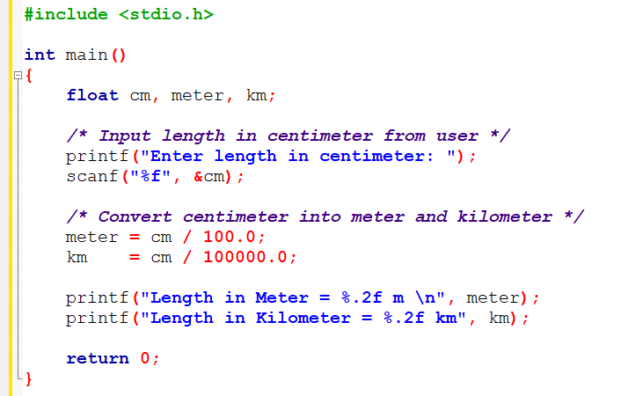
Program to Convert Centimeter to Meter and Kilometer

Slide 28
Area of a Triangle
h
Area A = .5 * h * b
b

Slide 29
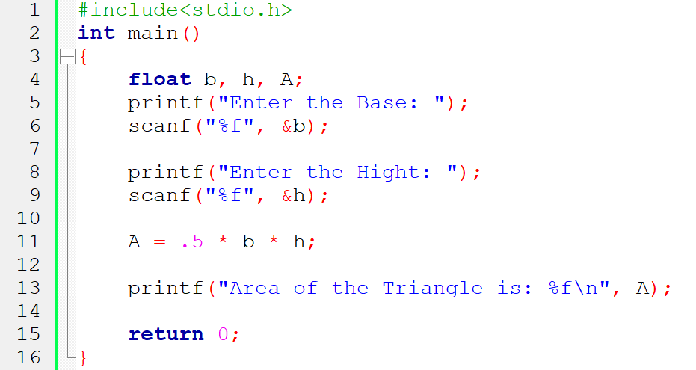
Area of a Triangle in C

Slide 30
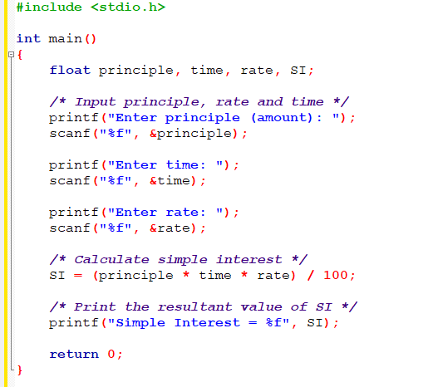
C Program to Calculate Simple Interest

Slide 31
Homework-1.2 and 1.3
Write a C program to find the area of a circle.
Write a C Program to convert days to years, weeks and days

Slide 32
Thank You

